Slide 1
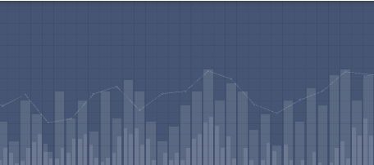
Bank Loan Case study

Slide 2
Project Description
In this bank loan case study, we're looking at customer data to better understand and reduce the chances of loan defaults. By checking things like customer habits and credit history, we want to find patterns that help us predict if someone can repay a loan. The goal is to use this info to make smarter decisions on who gets approved for a loan, making sure it's fair for everyone while keeping the bank secure from financial risks.

Slide 3
Approach
Thoroughly examine the provided dataset to understand its structure,
variables, and relationships.
Address missing or inconsistent data to ensure the reliability of analysis.
Handle outliers that may skew results.
Summarize key findings and insights derived from the analysis.
Provide actionable recommendations for the company to make informed
decisions about loan approvals, denials, and risk management.

Slide 4
Tech stack
Microsoft Excel
Microsoft Powerpoint
Google Drive
OBS Studio

Slide 5
Data Cleaning
I used the COUNT function for numerical columns and the COUNTA function for text columns to determine the total number of rows in each column.
Calculated the percentage of null values in each column using the formula (1 - count of filled cells / total count).
Removed columns with null value percentages exceeding 30%.
Replaced blank cells with the median for data completeness.
Retained only relevant variables to extract meaningful insights.
Converted days to years by dividing the values by 365 for consistency and clarity.

Slide 6
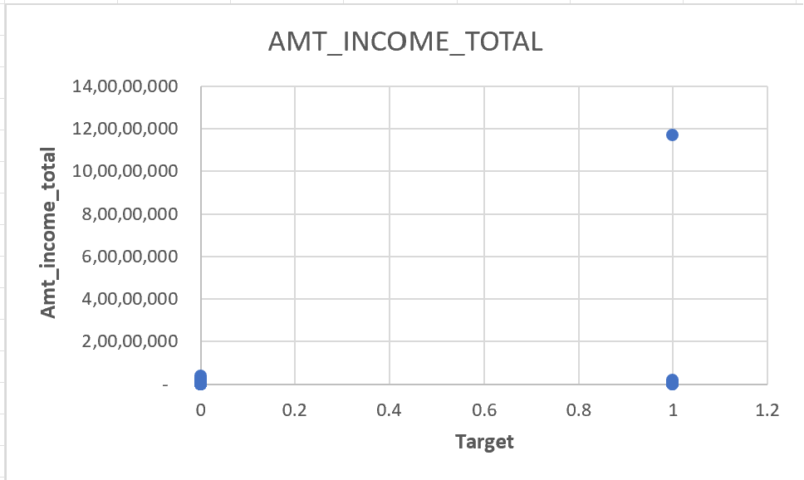
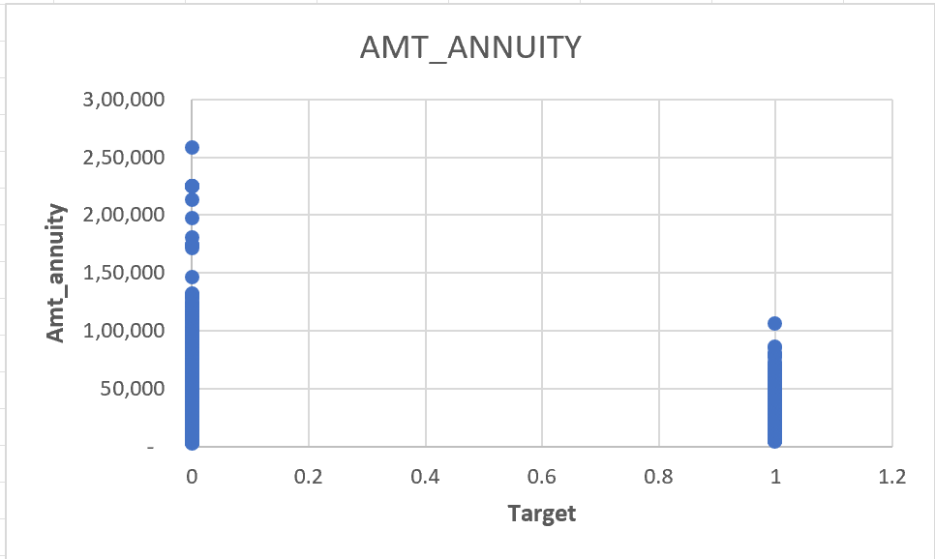
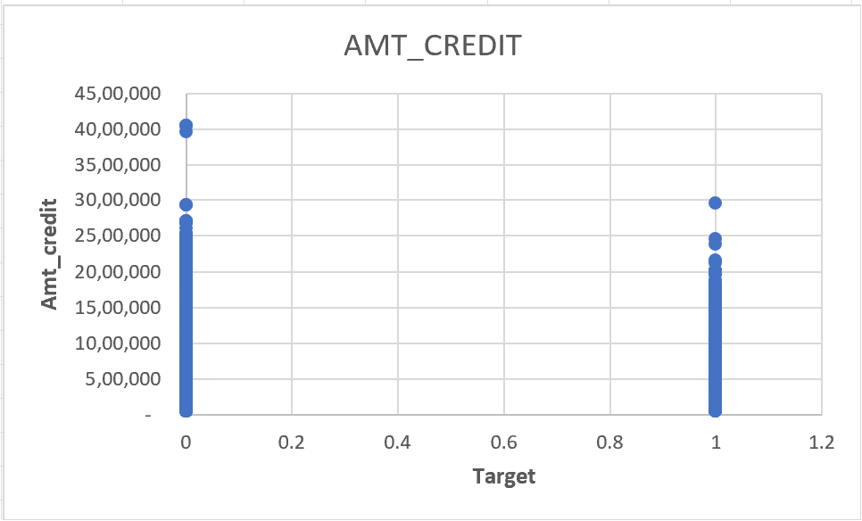
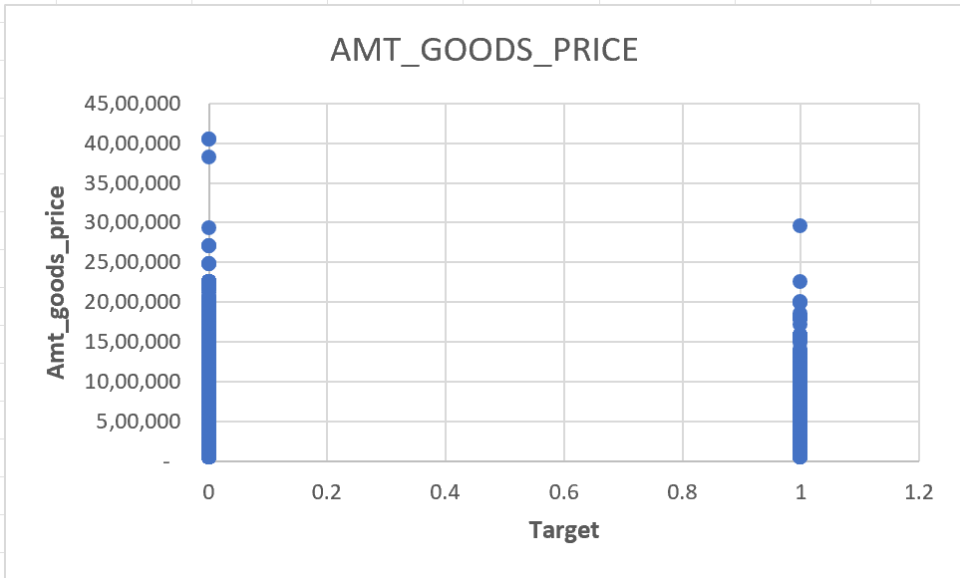
Outliers
I identified outliers by employing box and whisker plots, focusing on relevant variables for the analysis.

Slide 7
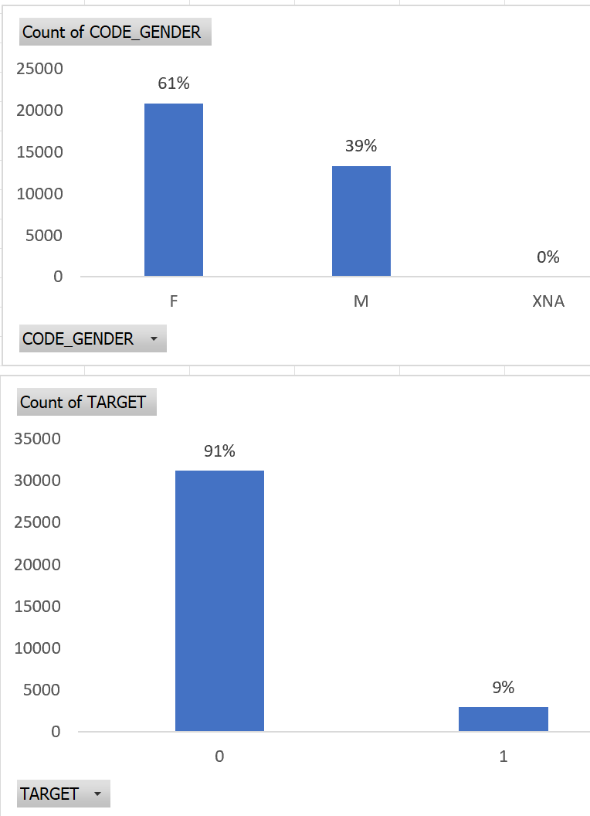
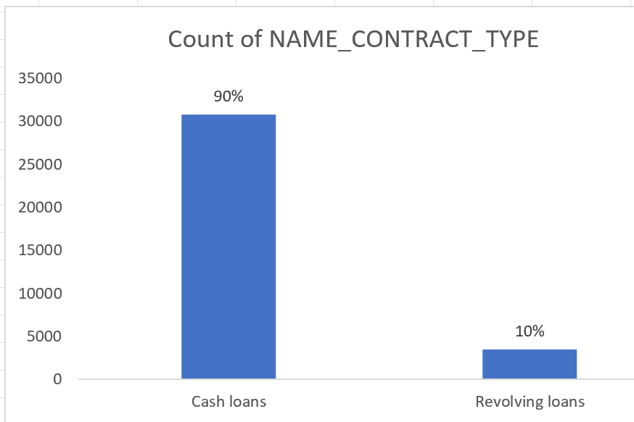
Data Imbalance
Data imbalance ratio:
Target - 91:9
Contract type – 90:10
Gender – 61:39

Slide 8
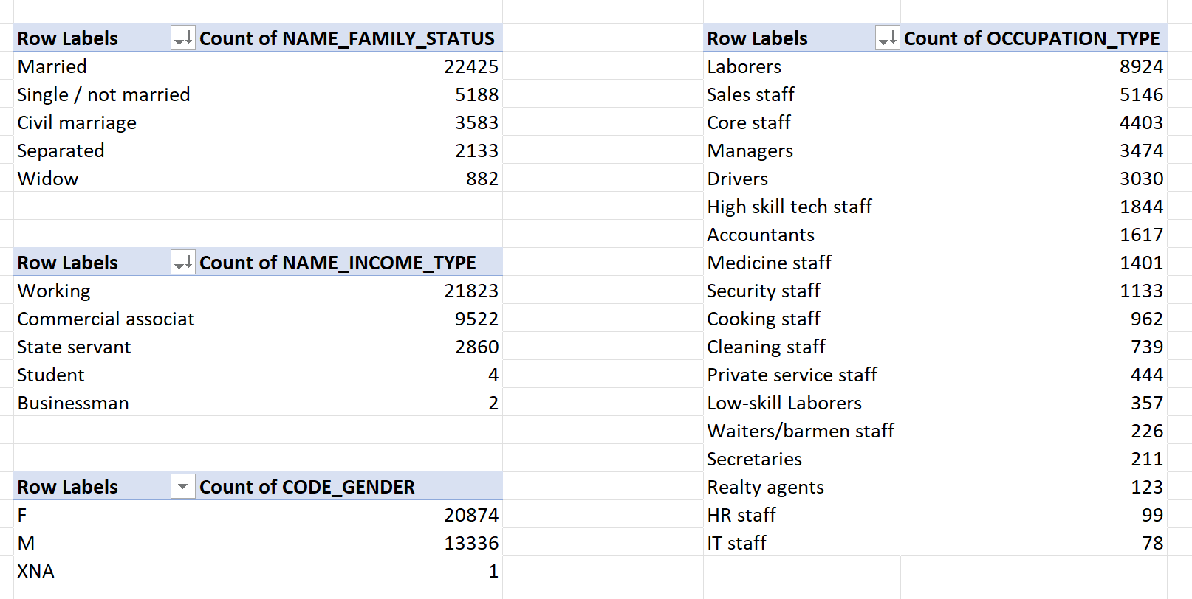
Univariate Analysis

Slide 9
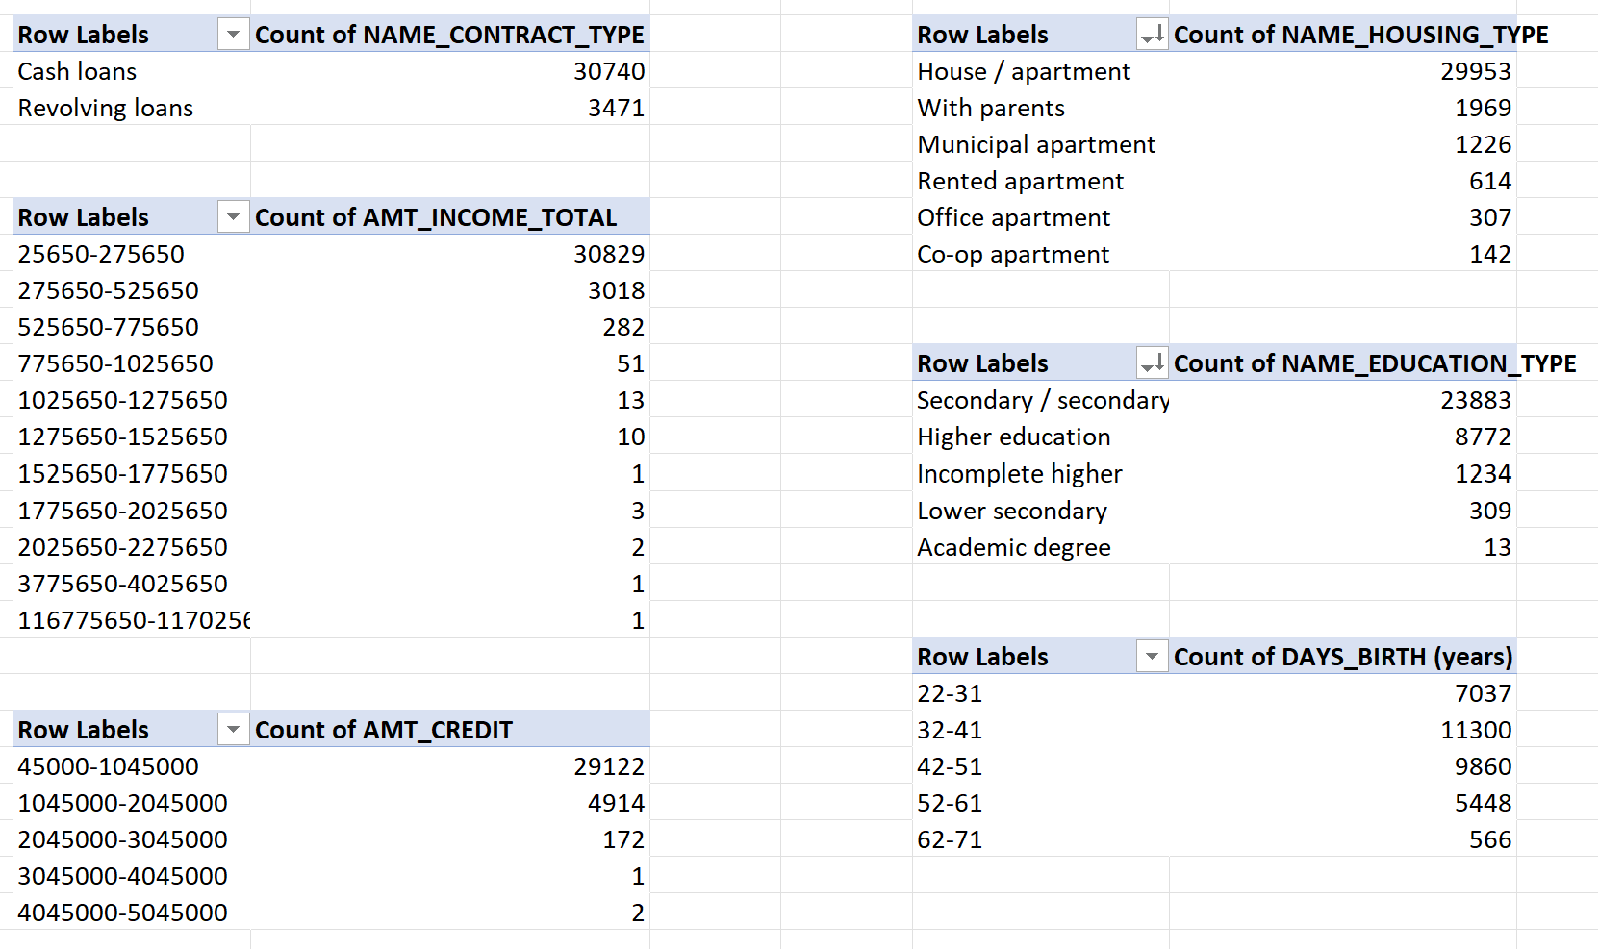

Slide 10
Individuals with higher incomes generally show a lower inclination to
apply for the loans
The income bracket between $25,000 and $275,000 exhibits the
highest likelihood of loan applications.
Bank loans typically fall within the range of $45,000 to $1,045,000.
Residents of houses or apartments are the primary applicants for loans.
The majority of loan applications originate from individuals aged between 30 and 40.
Married individuals have a higher frequency of loan requests.
Working individuals constitute the majority of loan applicants.

Slide 11
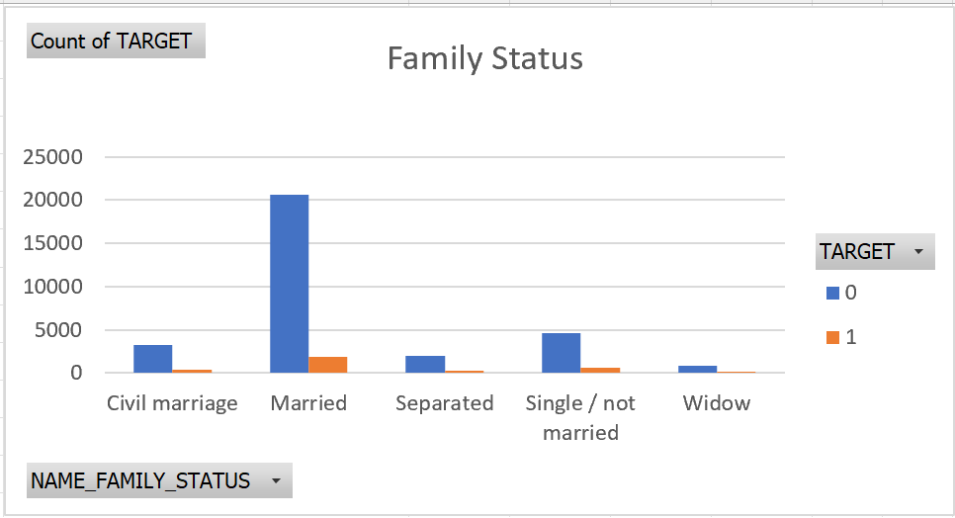
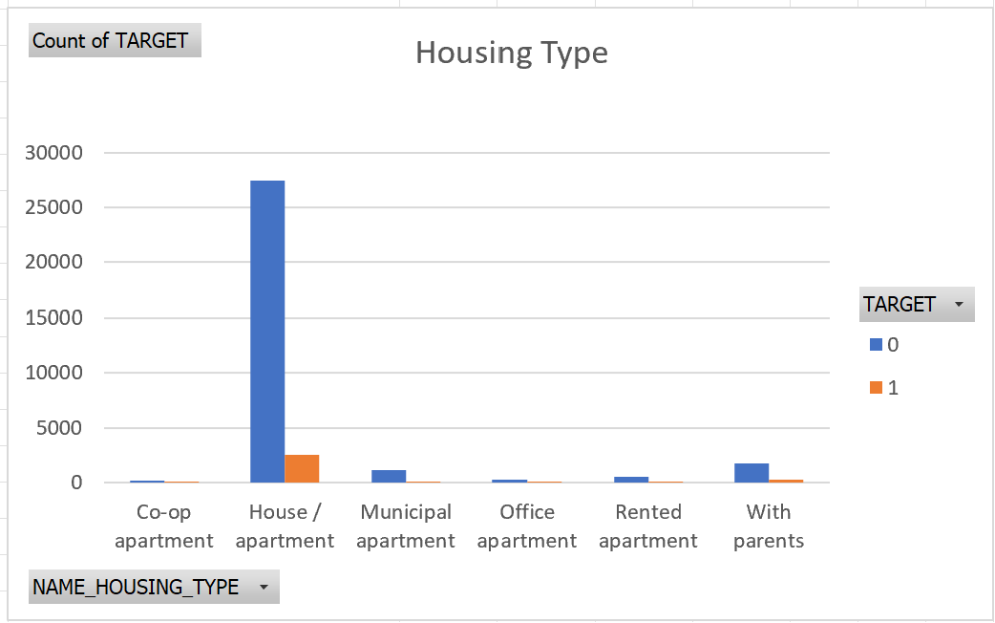
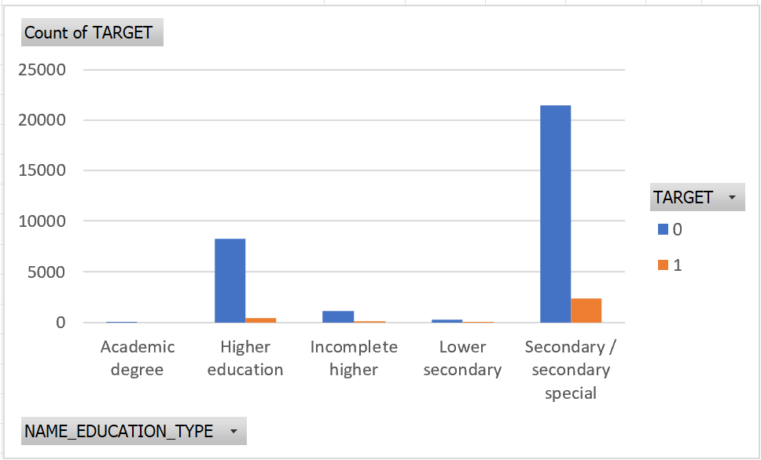
Bivariate analysis
Married individuals are more likely to be defaulters.
Customers who live in houses are associated
with higher default rates.
Customers with lower educational qualifications are
more prone to defaults.

Slide 12
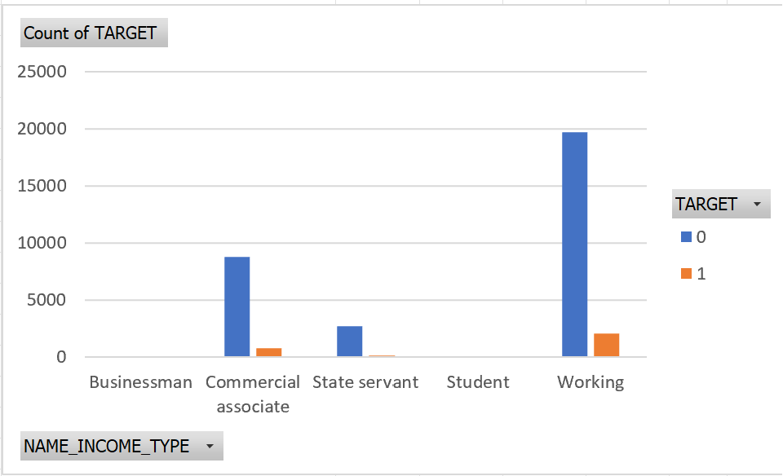
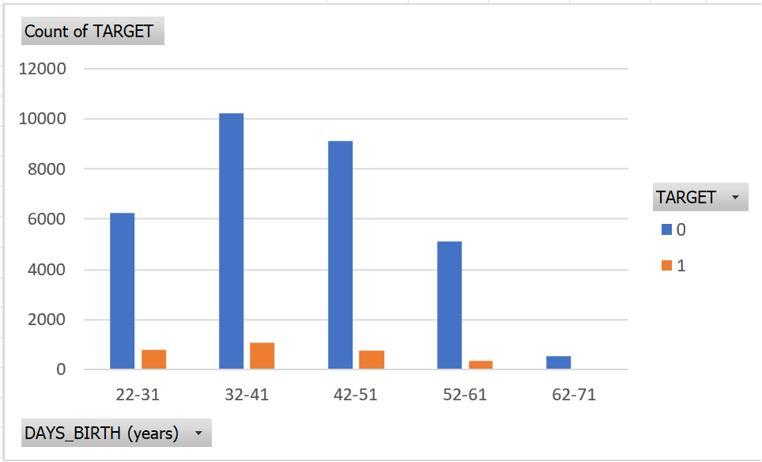
Young individuals are more likely to default on loans, and the trend of
defaulters decreases with age.
Working individuals are more likely to be defaulters.

Slide 13
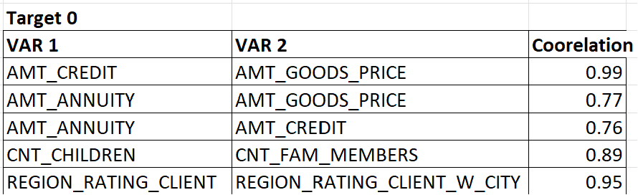
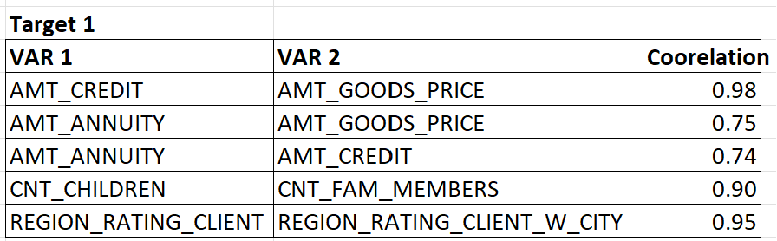
Correlation

Slide 14
Conclusion
From the above analysis, we can find out what kind of people can repay
loans, what kinds of loan people prefer to take, people taking loans come
from what background, what is source of income.
Excel File Link
https://docs.google.com/spreadsheets/d/1fbFO2fp2ZPQjTUdQSGq0fAWp__4V14AC/edit?usp=drive_link&ouid=103408304775565140342&rtpof=true&sd=true

Slide 15
THANK YOU

